Slide 1

YOGA – ALIGN PRO
App user manual.

Slide 2

CONTENTS:
1. Acknowledgements
2. About me…
3. My experience in the internship.
4. About my application
5. How to use my app
6. Questions please!

Slide 3

ACKNOWLEDGEMENTS
I have chosen the Yoga Pose Detection Project.
I want to give a small vote of thanks for all who have helped me in this journey of App Development – my parents, Avishek sir, Dr. Ken, Group Members, Friends, Sites, and many more.

Slide 4
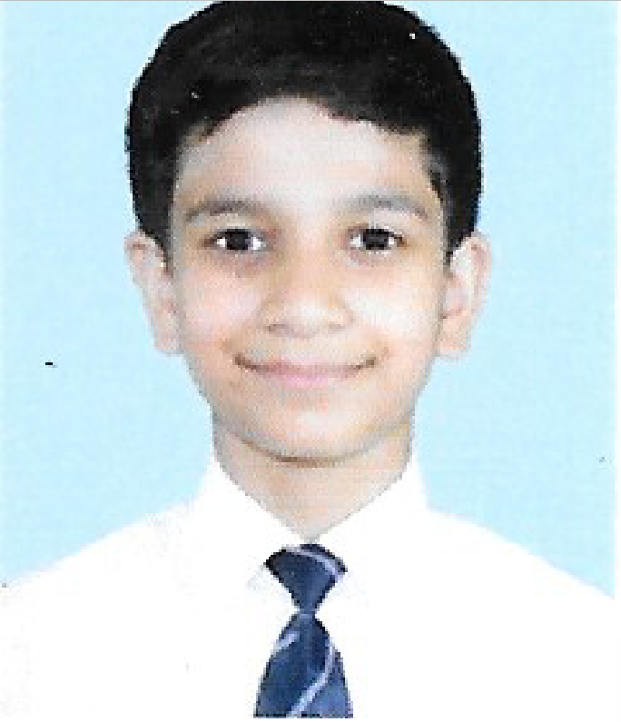
ABOUT ME…
My name is Faraz Ahmed Khan. I study in 9th grade, being 14 years of age. I like programming and AI development, and hope I can do very well in it.

Slide 5
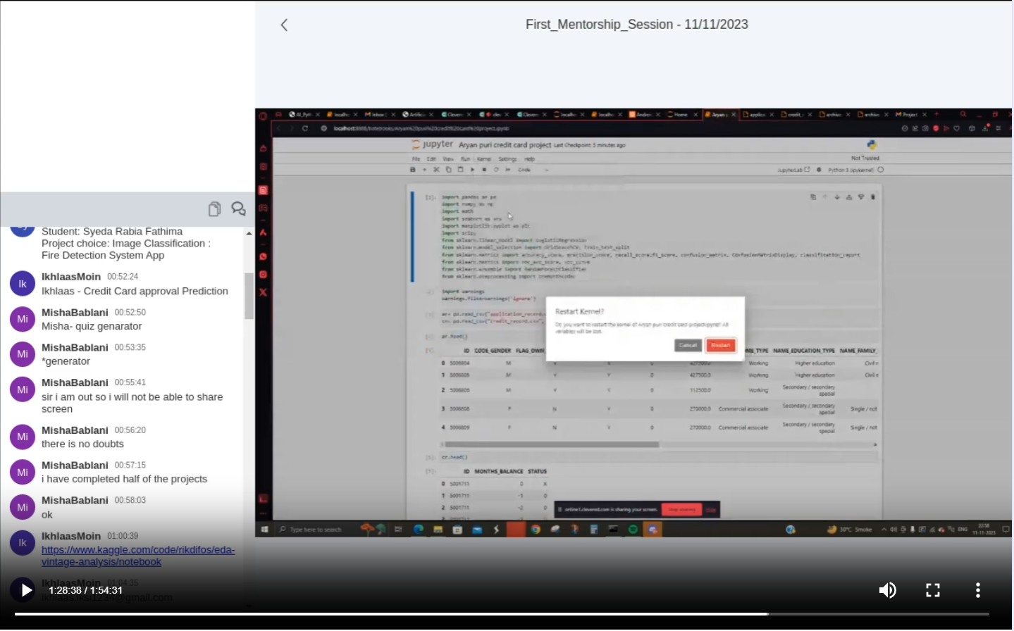

MY EXPERIENCE WITH THE INTERNSHIP
I am really having fun as well as learning many new things with the help of this internship.
Without its help, I couldn’t even think of making a complex project like this.
THANKYOU CLEVERED AND OXFORD!
A PICTURE FROM MENTORSHIP SESSION - I

Slide 6

ABOUT MY APPLICATION
INTRODUCTION – My yoga pose detection app has a goal to promote health and self – care to everybody it possibly can.
It uses modules, like cv2, matplotlib, mediapipe, and many more for detecting its poses.
It calculates the angles of each joint for detecting poses.

Slide 7
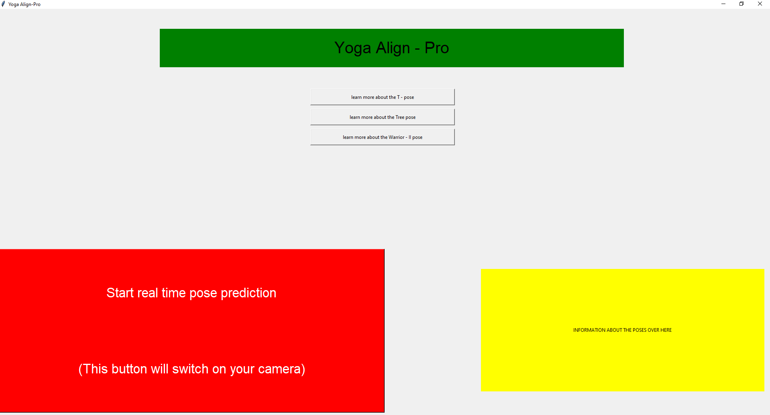
HOW TO USE MY APP?
Buttons to learn more about the poses
Initiate real time pose detection.
Info displayed here

Slide 8

QUESTIONS PLEASE!
In case there are any queries or doubts regarding my project, please email the same to: farazahmedkhansjs123@gmail.com
I would love to clear your doubts!

Slide 9
THANK YOU!

